Slide 1
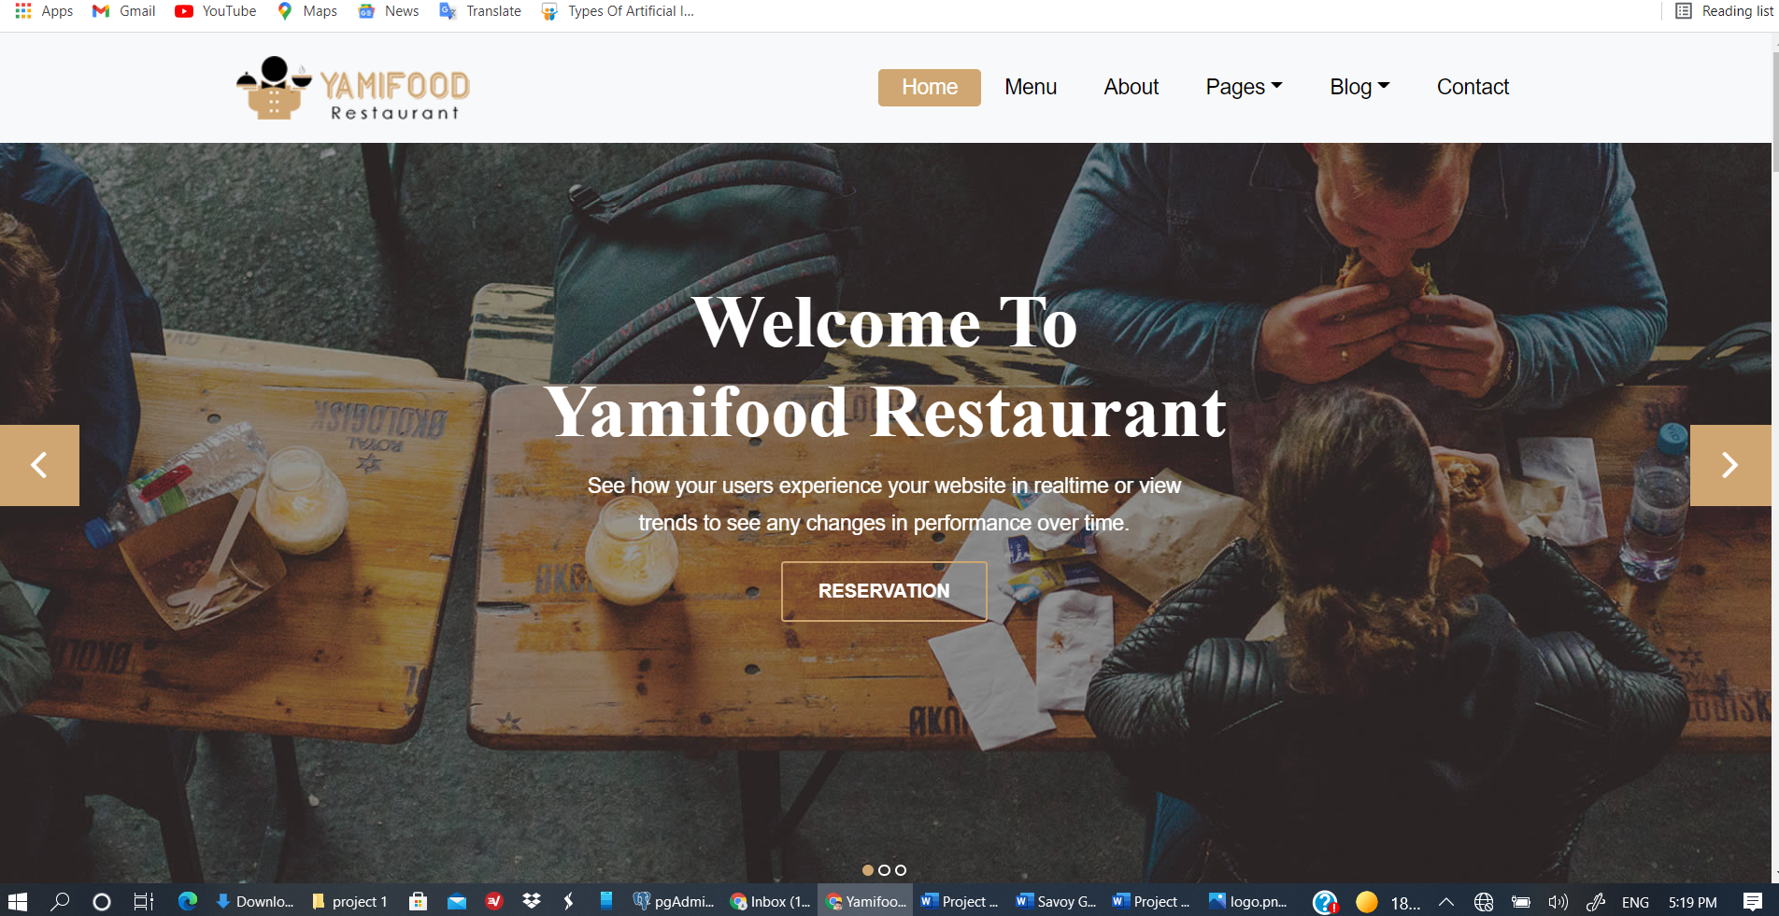
Sprint 1
Designing home page
Including Functions
logo

Slide 2
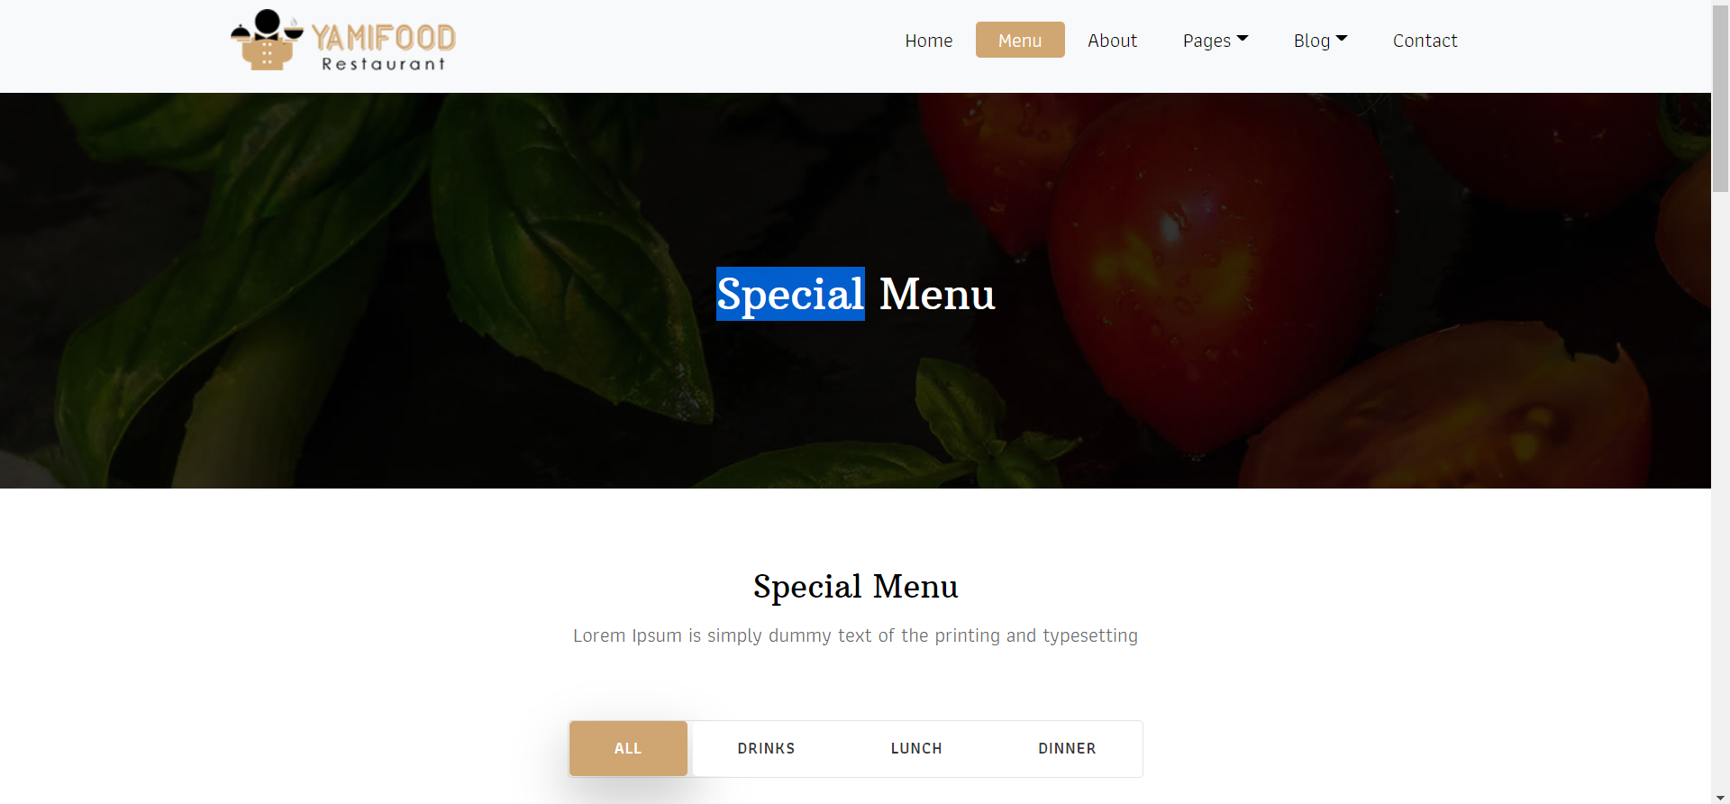
Sprint 2
Designing menu
Place to show menu
(home page or menu page)

Slide 3
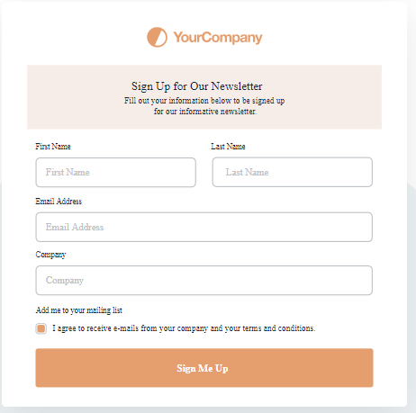
Sprint 3
Working on signup
List of details require signing up for both customer and staff.

Slide 4
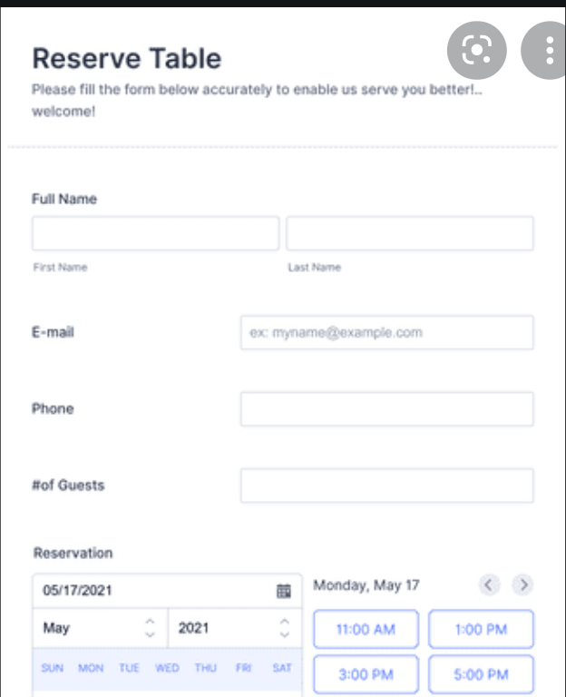
Sprint 4
Booking table/event
Details for booking
Way to inform staff

Slide 5
Sprint 5
Signnig up for Admin
Admin can update roster,menu,see booking,etc

Slide 6
Sprint 6
Login for staff
Staff can view roster

Slide 7
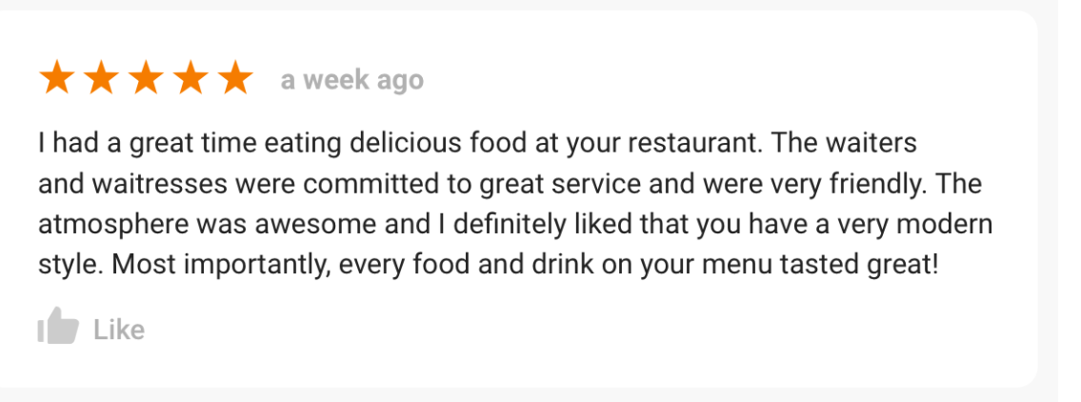
Sprint 7
Review
Customer can give feedback ( on main page / after login)

